Slide 1
SOUTH NIAGARA ROWING CLUB
2023
Awards

Slide 2
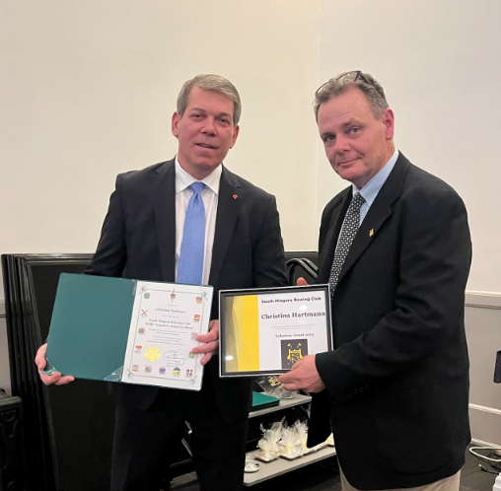
SOUTH NIAGARA ROWING CLUB
Volunteer Award of Merit
Christina Hartmann
Sponsored by: M.T. Bellies

Slide 3
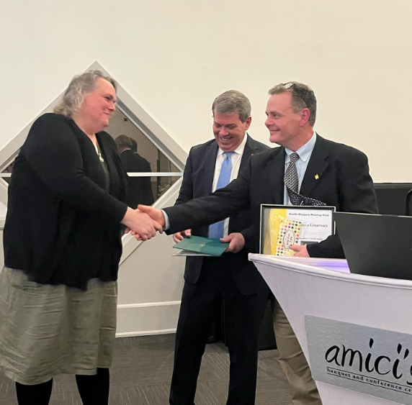
SOUTH NIAGARA ROWING CLUB
Volunteer Award of Merit
Jirianna Couroux
Sponsored by: A Third Space Pottery Studio

Slide 4
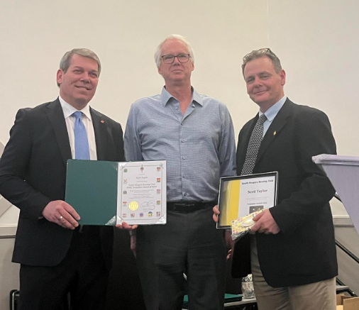
SOUTH NIAGARA ROWING CLUB
Volunteer Award of Merit
Scott Taylor
Sponsored by: M.T. Bellies

Slide 5
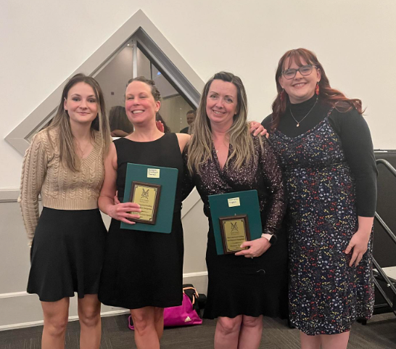
SOUTH NIAGARA ROWING CLUB
Most Improved Sculling Development
Barbara Wimbush Farrell
Melissa Capes
Sponsored by: Best Western Rose City Suites

Slide 6
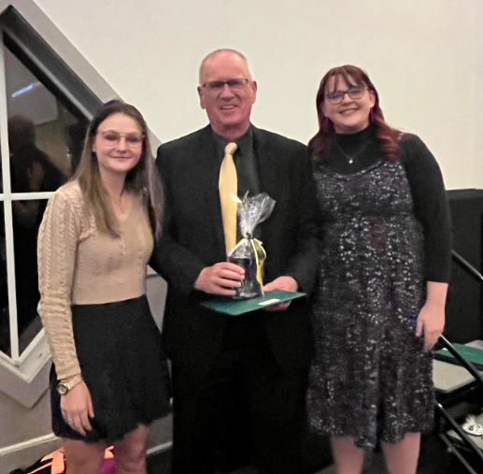
SOUTH NIAGARA ROWING CLUB
Masters Development Leadership Award
Robert Fowler
Sponsored by: Residence & Conference Centre

Slide 7
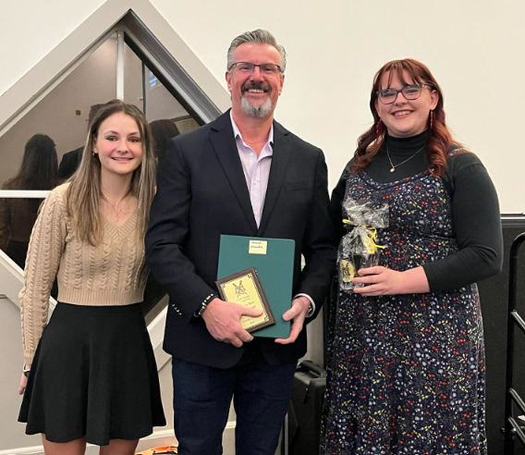
SOUTH NIAGARA ROWING CLUB
Learn to Row Spirit Award
Hank Nauta
Sponsored by: CHA Canada

Slide 8
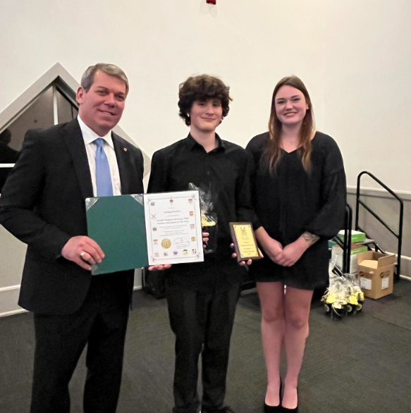
SOUTH NIAGARA ROWING CLUB
Novice Oarsman of the Year
Jeremy Hauber
Sponsored by: Holiday Inn Express & Suites Welland

Slide 9
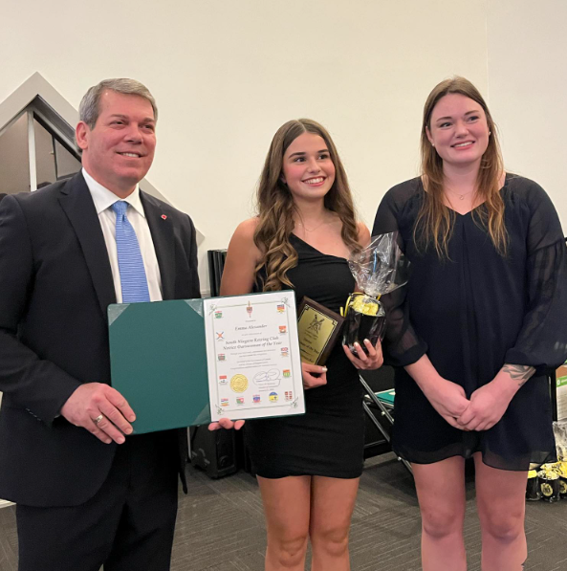
SOUTH NIAGARA ROWING CLUB
Novice Oarswomen of the Year
Emma Alexander
Sponsored by: Holiday Inn Express & Suites Welland

Slide 10
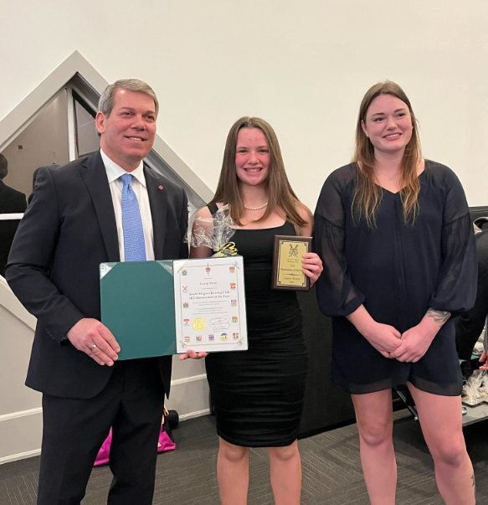
SOUTH NIAGARA ROWING CLUB
U17 Oarswoman of the Year
Lacey Stone
Sponsored by: Pelham Today

Slide 11
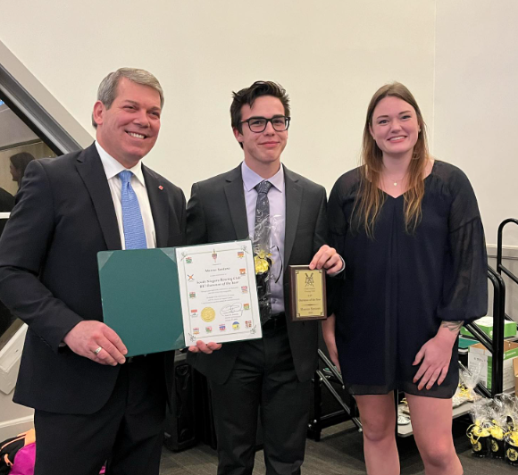
SOUTH NIAGARA ROWING CLUB
U17 Oarsman of the Year
Marcus Santoro
Sponsored by: Pelham Today

Slide 12
SOUTH NIAGARA ROWING CLUB
U19 Oarswoman of the Year
Abigail Welch
Sponsored by: M.T. Bellies

Slide 13
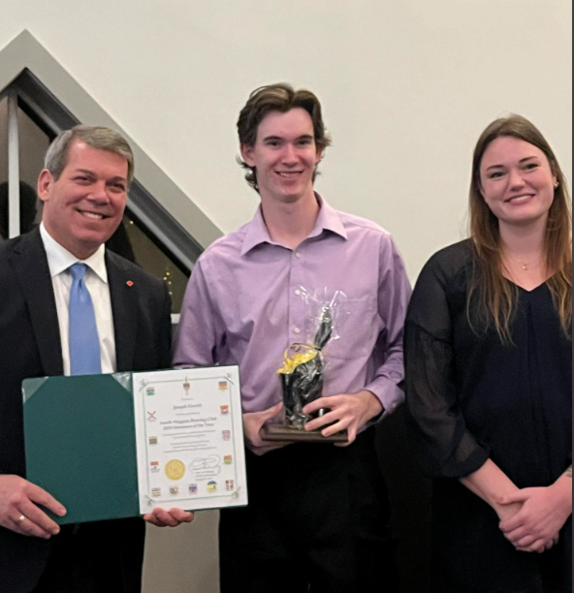
SOUTH NIAGARA ROWING CLUB
U19 Oarsman of the Year
Joseph Everitt
Sponsored by: Ontario Power Generation

Slide 14
SOUTH NIAGARA ROWING CLUB
Most Improved Masters
Oarsperson of the Year
James Leigh
Sponsored by: Precision Welding

Slide 15
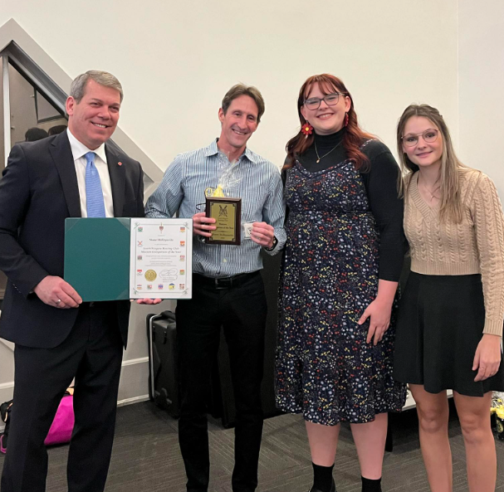
SOUTH NIAGARA ROWING CLUB
Masters Oarsperson of the Year
Shane McReynolds
Sponsored by: Plants Choice

Slide 16
SOUTH NIAGARA ROWING CLUB
Board of Directors Award
James McClean
Sponsored by: Pelham Today

Slide 17
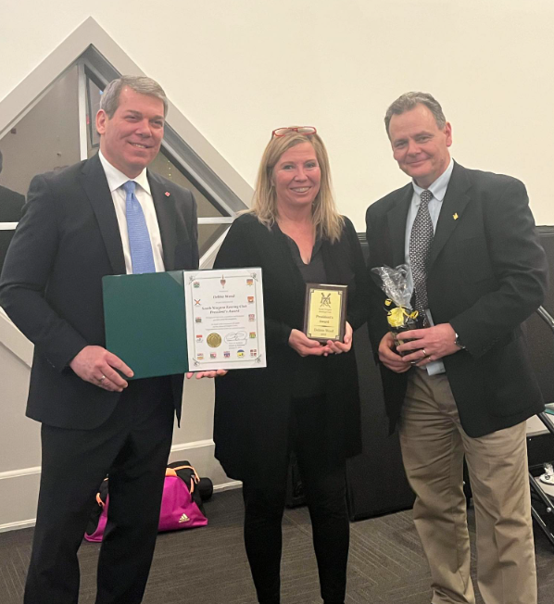
SOUTH NIAGARA ROWING CLUB
SNRC President’s Award
Debbie Wood
Sponsored by: Holiday Inn Express & Suites Welland

Slide 18
SOUTH NIAGARA ROWING CLUB
Thank You to our Sponsors
GOLD SPONSORS:
Holiday Inn Express & Suites Welland
Pelham Today
SILVER SPONSOR:
M.T.Bellies
BRONZE SPONSORS:
Best Western Rose City Suites, CHA Canada, OPG,
Residence Conference Centre, Plants Choice, Precision Welding, A Third Space Pottery

